Slide 1
Predicting if income exceeds $50,000 per year based on 1994 US Census Data
Capstone Project 2
Prince Sekyi

Slide 2
Problem Statement and Goals

Slide 3
Problem Statement
Income inequality is the extent to which income is distributed. The distribution of income is very important for the economic growth of any country. Over the years this topic has been the concern of the government and other international organizations. In the United States, income inequality has been of so much concern and a lot of factors have been attributed to the uneven distribution of income.

Slide 4
Goals
This project will investigate
factors that affect the income level of an individual
Use machine learning to predict the income level of an individual

Slide 5
Data Cleaning and Data Wrangling

Slide 6
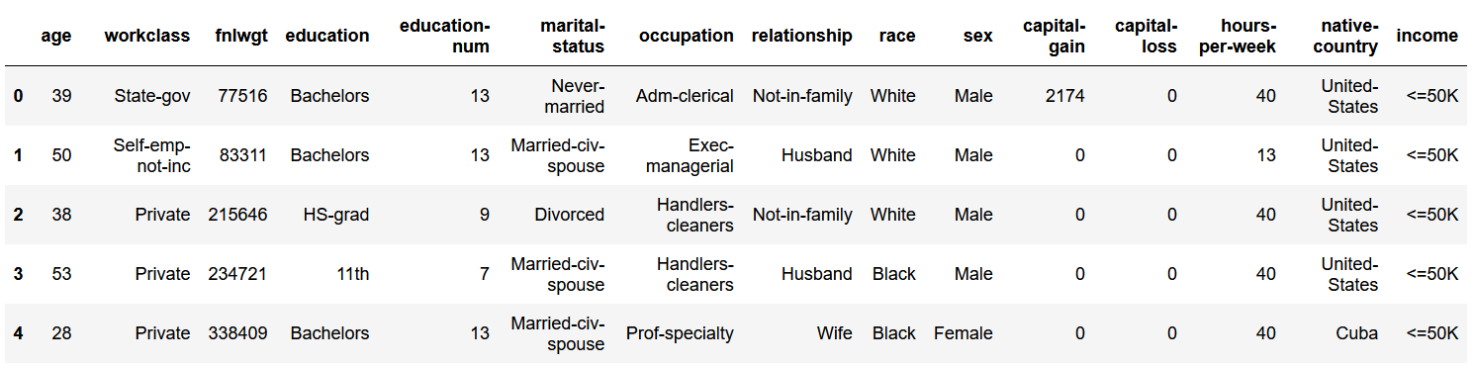
Below is the original data

Slide 7
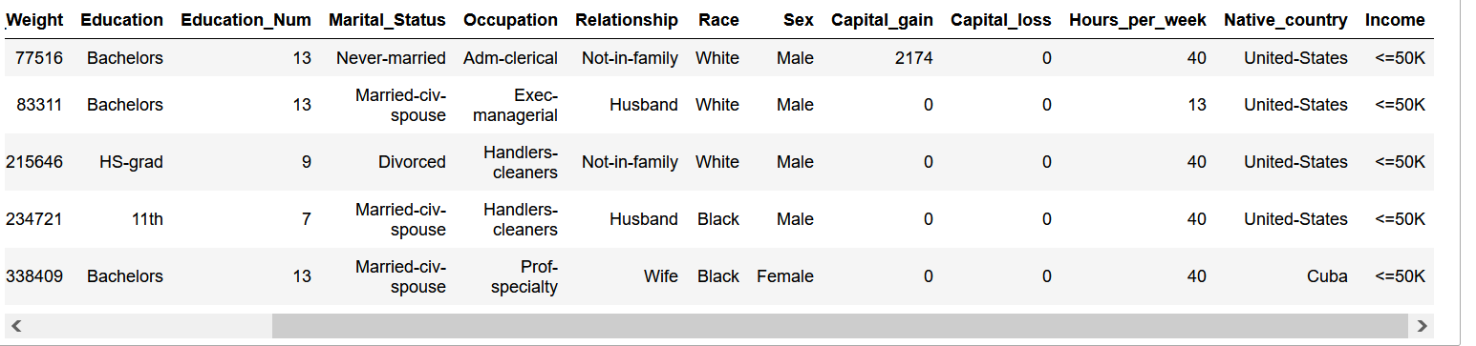
Below is the clean data
Missing values were removed
Variable names were cleaned and written appropriately

Slide 8
Exploratory Data Analysis

Slide 9
Dataset
Age​: the age of an individual
Workclass​: a general term to represent the employment status of an individual
Fnlwgt​: final weight. In other words, this is the number of people the census believes the entry represents.
Education​: the highest level of education achieved by an individual.
Education_Num​: the highest level of education achieved in numerical form.
Marital_Status​: marital status of an individual.

Slide 10
Dataset
Occupation​: the general type of occupation of an individual
Relationship​: represents what this individual is relative to others.
Race​: Descriptions of an individual’s race
Sex​: the biological sex of the individual
Capital_Gain​: capital gains for an individual
Capital_Loss​: capital loss for an individual
Hours_Per_Week​: the hours an individual has reported to work per week
native­country​: country of origin for an individual
Income​: whether or not an individual makes more than $50,000 annually

Slide 11
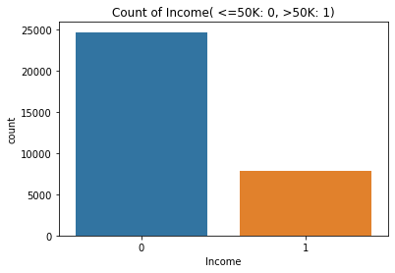
EDA contiunes
Label | Count
<=50K (0) | 7841
>50K(1) | 24720

Slide 12
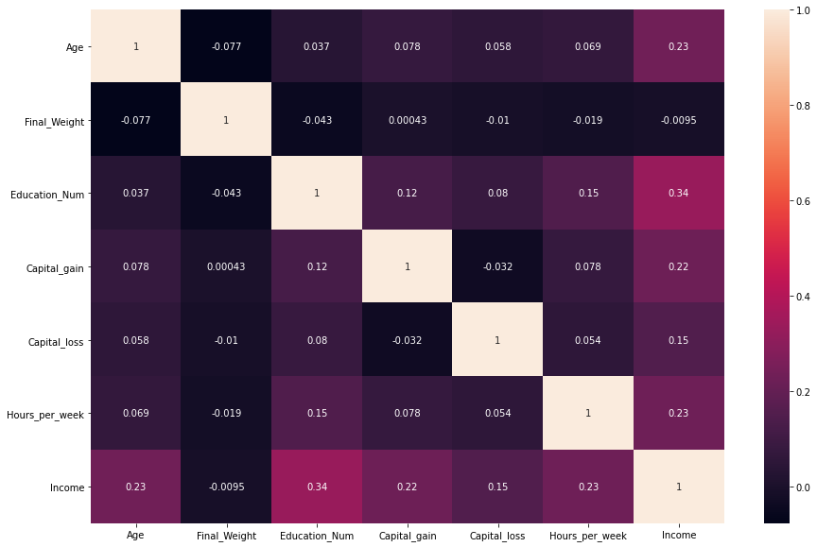
Heat Map

Slide 13
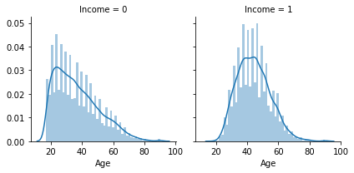
Comparing Age with Income

Slide 14
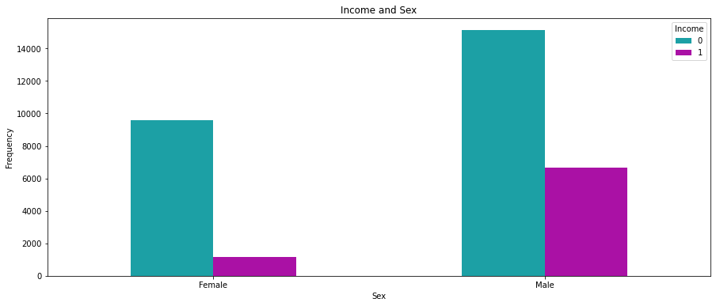
Comparing Sex with Income

Slide 15
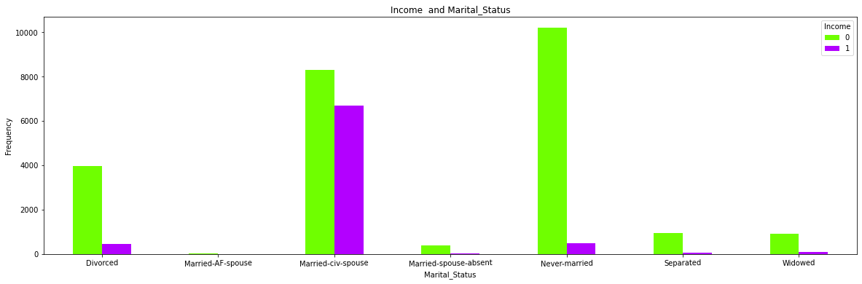
Income and Marital Status

Slide 16
Pre-Processing and Modeling

Slide 17
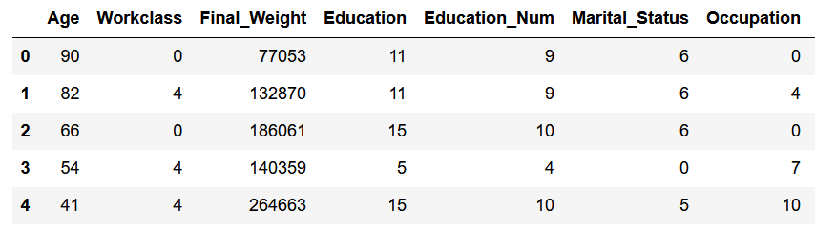
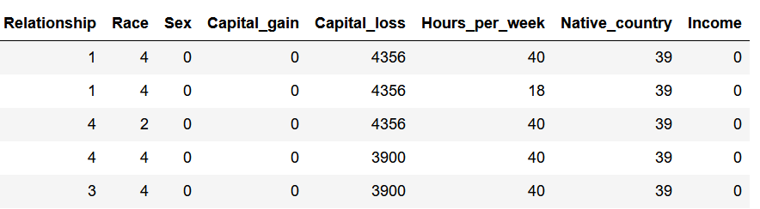
Qualitative variables in the dataset were encoded into numerical values

Slide 18
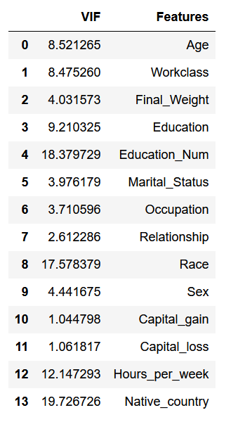
Multicollinearity Check
Features with VIF(Variance inflation factor ) greater than 10 will be dropped

Slide 19
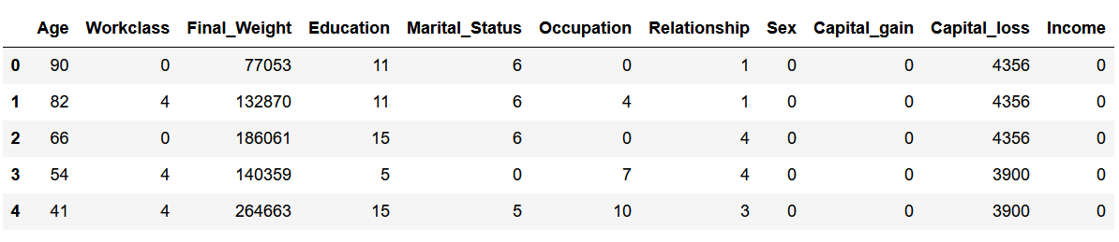
This is the final data which is spilt into test and train to be used for modelling
Data for Modelling

Slide 20
Modelling
The Model used in this Project are
Logistic Regression
K-Nearest Neighbors Algorithm (KNN)

Slide 21
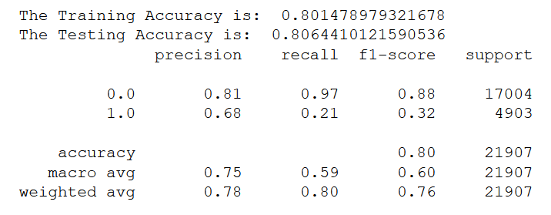
Logistic Regression Model (LRM)

Slide 22
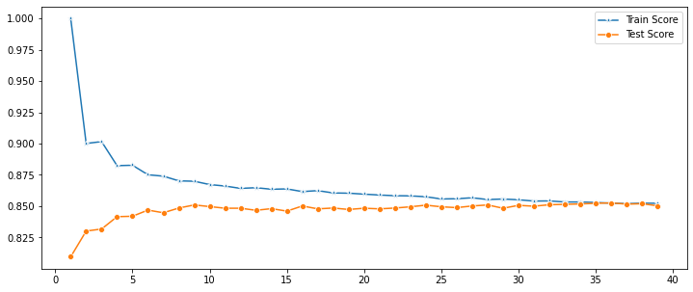
K-Nearest Neighbors Algorithm
k=36 has the highest score for the testing data

Slide 23
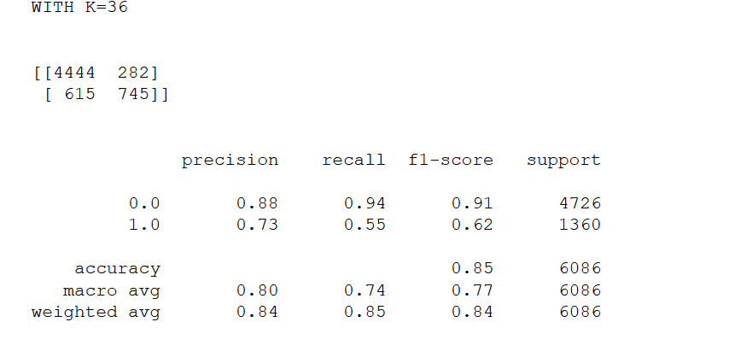
K-Nearest Neighbors Algorithm

Slide 24
End Thank You Very Much

